Slide 1
Models and designing schemas

Slide 2




My team
MEHAR CHOUDHARY MEENAVILLI
DASARI VENKAT SAI KRISHNA
AAKASH VALLURU
PEDDI TARAK RAVITEJA

Slide 3
INtroduction
Model is merely a human construct which represents the real world systems.
In software development, a model is overloaded to cover a lots of concepts.
There are different types of models like software maturity models, design models, process models, business-oriented models and view-specific models.
MEHAR CHOUDHARY MEENAVILLI

Slide 4
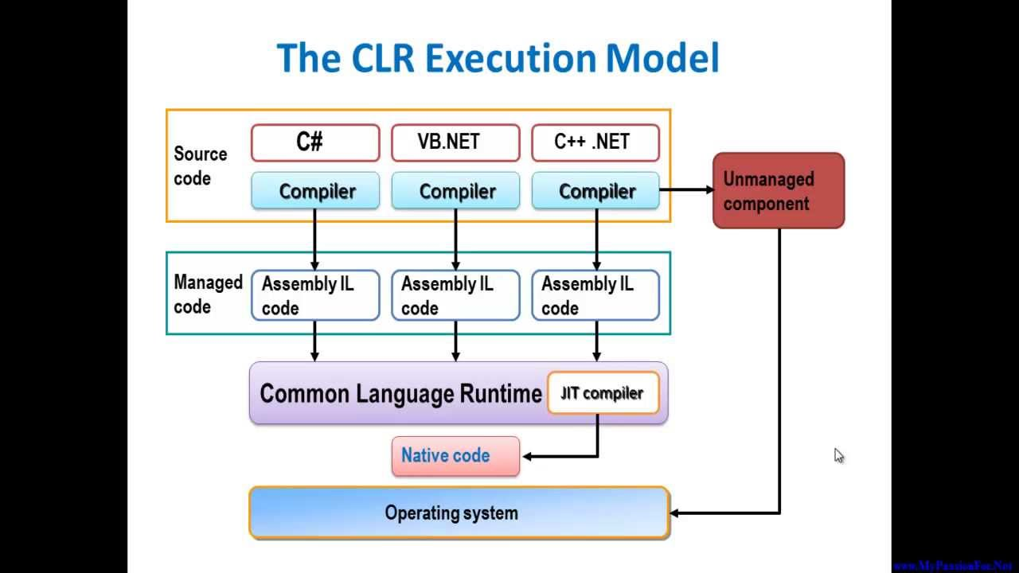

Slide 5
MVC Model
The main purpose is to describe data-related information.
It is used to hold and manipulate the application data.
It provides separation of concerns
MEHAR CHOUDHARY MEENAVILLI

Slide 6
MVC Model
Typed objects allow compile-time checking and Intellisense
Define the schema, the table definitions
Class property = database column
Aakash Valluru

Slide 7
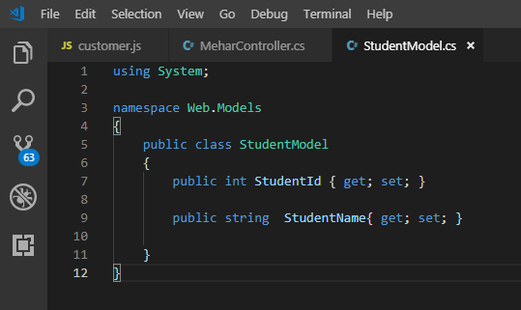
Mvc model
Aakash Valluru

Slide 8
Mvc model
A model is a file of C# code and an associated data store, e.g., an SQL database or XML file.
The file of C# code manages all access to the application’s data through objects.
Linq to SQL and Linq to XML create queries into these data stores
This can be direct and more often it is done through objects that wrap db tables or XML files and have one public property for each attribute column of the table.
MEHAR CHOUDHARY MEENAVILLI

Slide 9
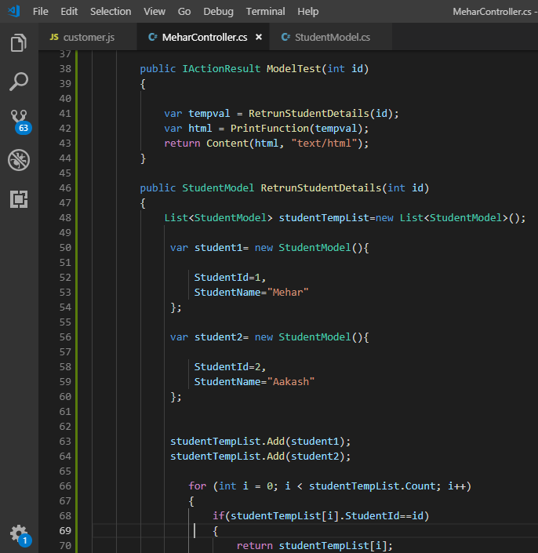
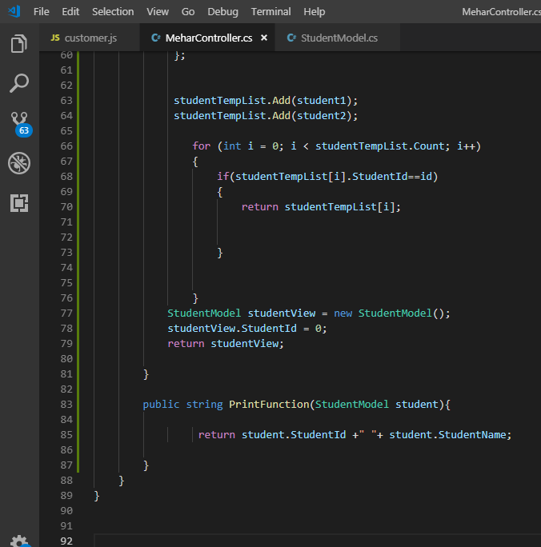
Mvc model
Aakash Valluru

Slide 10
Designing schemas
Schema in simple can be known as the implementation of the model.
When organizing your data into tables, it might be beneficial to group the tables and other related objects together.
When designing your databases and tables, you should also consider the schemas in your system, including their names and the objects that will be associated with each of them.
Dasari Venkat

Slide 11
Schemas in .net
XML data can be validated against all the three schema languages using the .NET classes.
System.Xml.XmlValidatingReader is used for validation.
System.Xml.Schema is the namespace for the XML classes that provide standards-based support for XML schemas (for structures and data types).
System.Xml.Schema.XmlSchemaCollection Class contains a cache of XSD and XDR schemas.
Dasari Venkat

Slide 12
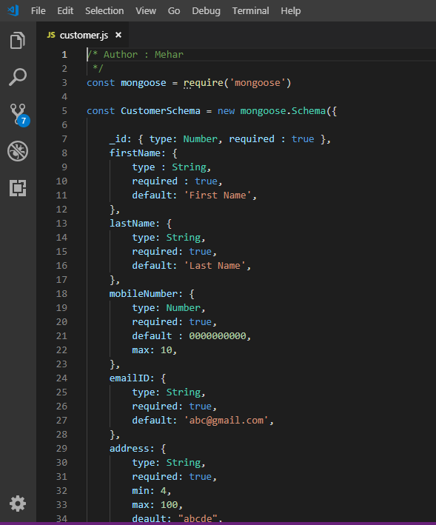
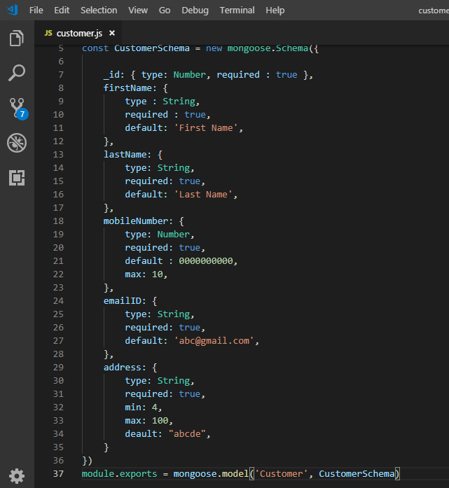
Schemas
Ravi Teja

Slide 13
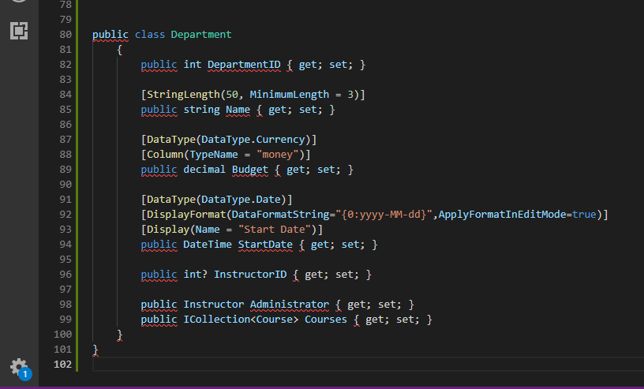
.net Schemas
Ravi Teja

Slide 14


